Slide 1




Sales Management System
Sales Data Analysis & Dashboard
Team Members
Nirupama Dwivedi
Shreya Sharma
Trisha Upadhayay
Siddhi Kesharwani
Guided by
Shailesh Yadav

Slide 2
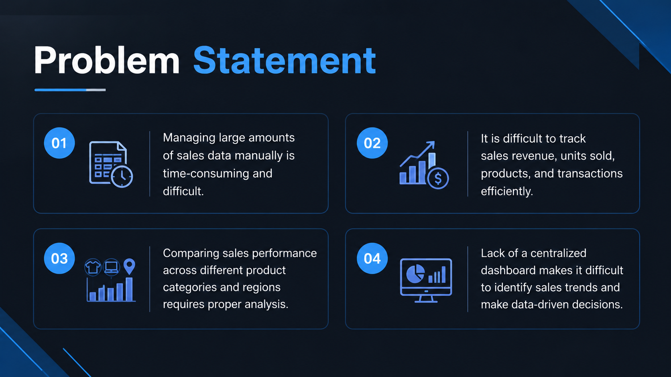

Slide 3
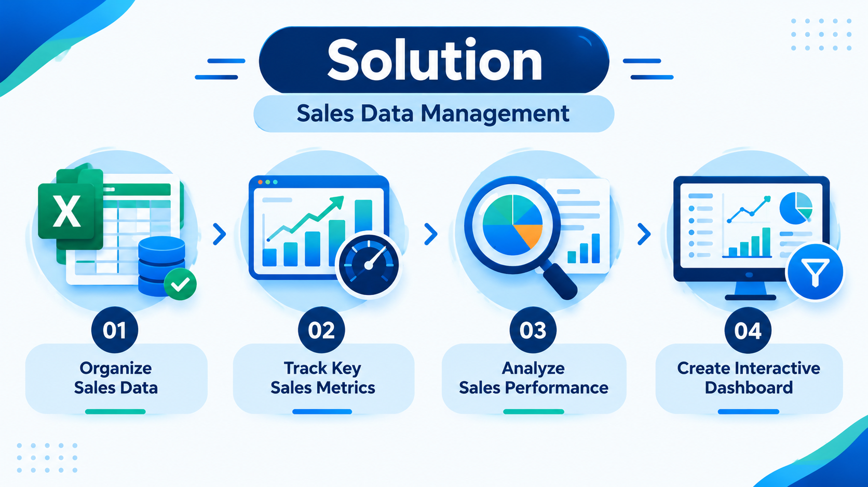
Solution
Organize Sales Data
Manage and organize sales transactions in a structured Excel format.
Track Key Sales Metrics
Track total revenue, units sold, transactions, and average unit price
Analyze Sales Performance
Analyze sales based on product categories, regions, and payment methods.
Create an Interactive Dashboard
Visualize sales performance using charts, graphs, and summaries for better analysis.

Slide 4
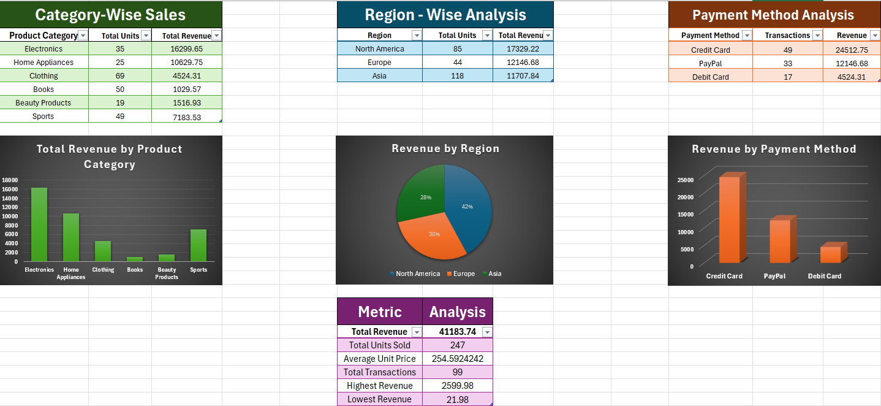
Project Demo

Slide 5

Future Scope
Sales Forecasting
Predict future sales and demand using historical sales data.
Inventory Management
Monitor stock levels and manage inventory efficiently.
Automated Reporting
Generate sales reports automatically for faster analysis.
Advanced Dashboard
Add interactive filters, KPIs, and advanced visualizations for better insights.

Slide 6

Conclusion
The project successfully analyze sales data using Microsoft Excel.
It provides clear insights into revenue, units sold, transactions, categories, and regions.
The dashboard makes sales performance easier to understand through KPIs, charts, filters, and analysis.
The workbook can be updated with new transactions and the analysis can be refreshed for future use.

Slide 7

Notes:
Thank You !!

